Slide 1
Java – Regular Expression

Slide 2
Regular Expressions
The Java Regex or Regular Expression is an API to define a pattern for searching or manipulating strings
It is widely used to define the constraint on strings such as password and email validation.
Java Regex API provides interface and classes to implement Regex using java.util.regex package.

Slide 3
Regular Expressions
java.util.regex package
The Matcher and Pattern classes provide the facility of Java regular expression. The java.util.regex package provides following classes and interfaces for regular expressions.

Slide 4

Regular Expressions

Slide 5
Regular Expressions
Matcher class:
It implements the MatchResult interface. It is a regex engine which is used to perform match operations on a character sequence.
Pattern class
It is the compiled version of a regular expression. It is used to define a pattern for the regex engine.

Slide 6
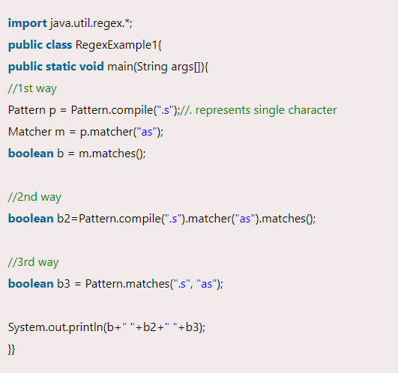
Regular Expressions

Slide 7
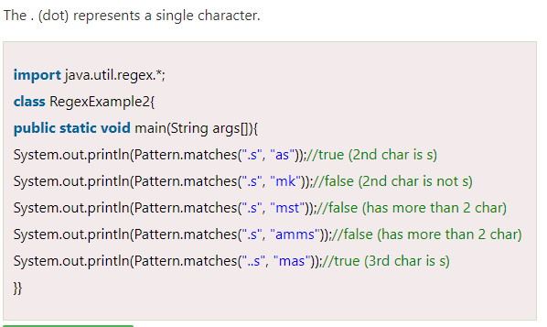
Regular Expressions

Slide 8
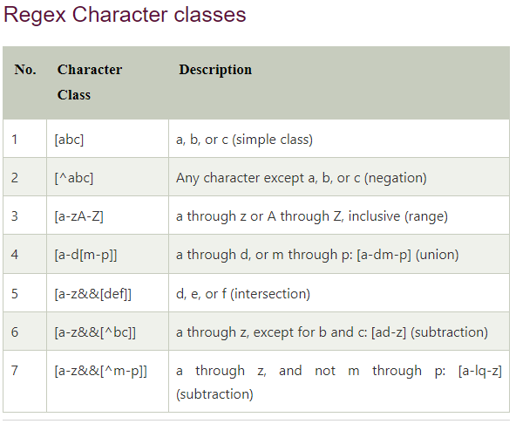
Regular Expressions

Slide 9
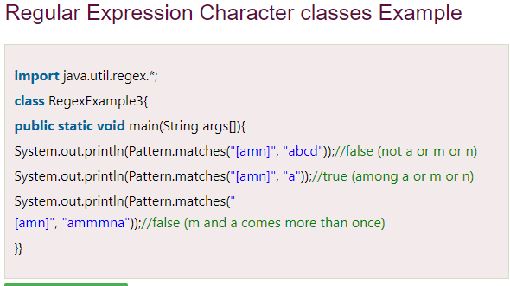
Regular Expressions

Slide 10
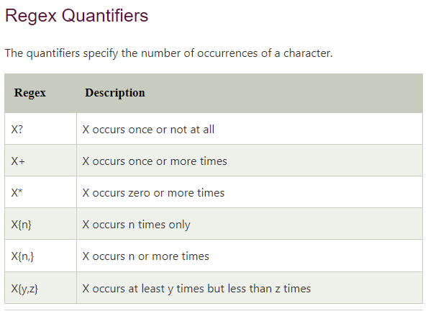
Regular Expressions

Slide 11
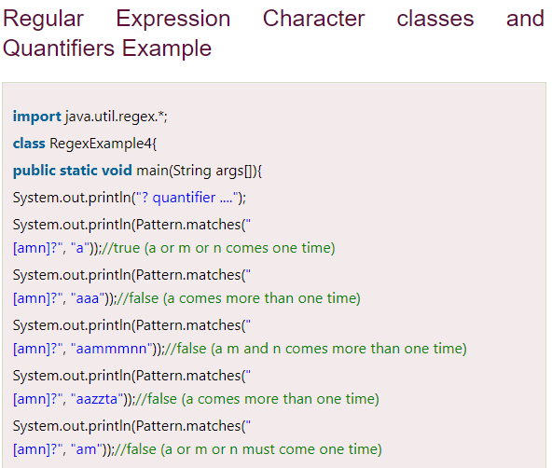
Regular Expressions

Slide 12
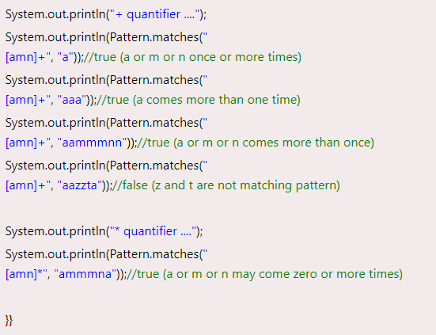
Regular Expressions

Slide 13
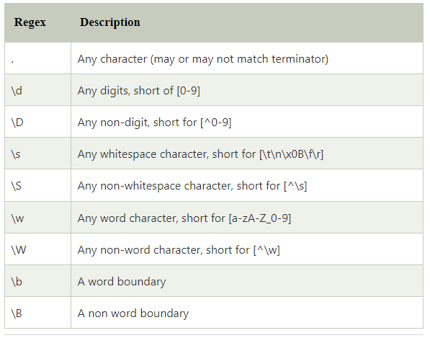
Regular Expressions
Regex Metacharacters
The regular expression metacharacters work as shortcodes.

Slide 14
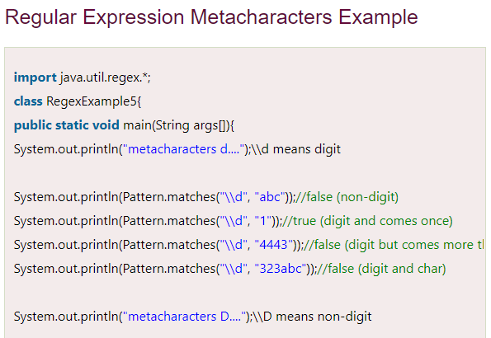
Regular Expressions

Slide 15
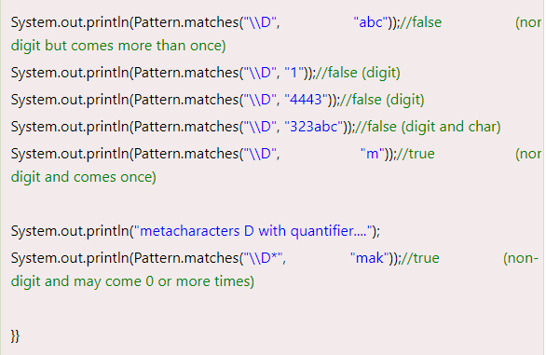
Regular Expressions

Slide 16
Regular Expressions
Example:
Create a regular expression that accepts alphanumeric characters only. Its length must be six characters long only.

Slide 17
Regular Expressions
Example:
Create a regular expression that accepts alphanumeric characters only. Its length must be six characters long only.

Slide 18
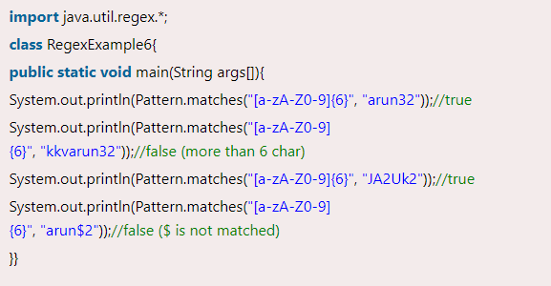
Regular Expressions

Slide 19
Regular Expressions
Example:
Create a regular expression that accepts 10 digit numeric characters starting with 7, 8 or 9 only.

Slide 20
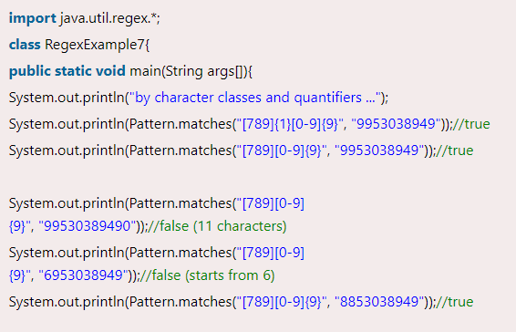
Regular Expressions

Slide 21
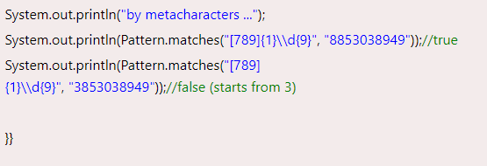
Regular Expressions

Slide 22
Regular Expressions (Finder Class)
import java.util.regex.Pattern; import java.util.Scanner; import java.util.regex.Matcher; public class RegexExample8{ public static void main(String[] args){ Scanner sc=new Scanner(System.in); while (true) { System.out.println("Enter regex pattern:"); Pattern pattern = Pattern.compile(sc.nextLine()); System.out.println("Enter text:"); Matcher matcher = pattern.matcher(sc.nextLine()); boolean found = false; while (matcher.find()) { System.out.println("I found the text "+matcher.group()+" starting at index "+ matcher.start()+" and ending at index "+matcher.end()); found = true; } if(!found){ System.out.println("No match found."); } } } }

